Slide 1
What senior developers know
Transitioning from Junior to Senior Developer

Slide 2
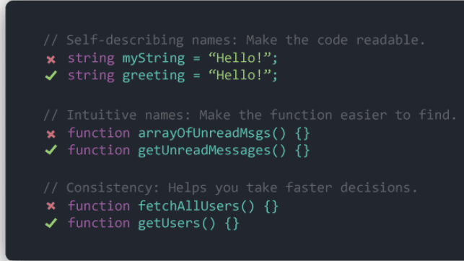
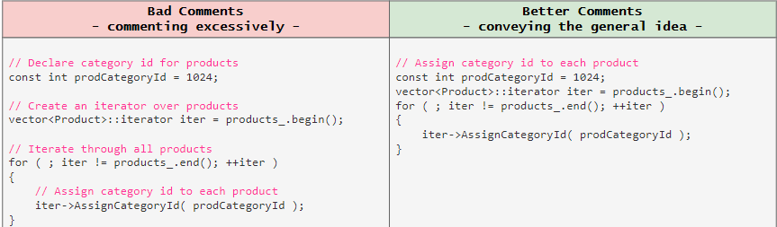
Clarity is King
Importance of Readable Code
Code for Debugging
code easy to read === code easy to debug
Comments vs Clear code

Slide 3


Avoiding Complexity
Single Responsibility Principle
Every module or function should have responsibility
over a single part of the functionality
Example :- Calculate Average

Slide 4
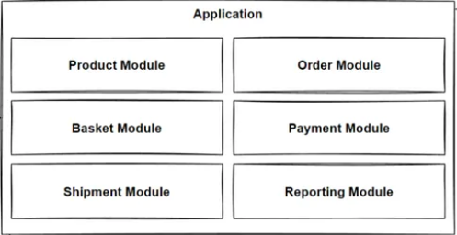
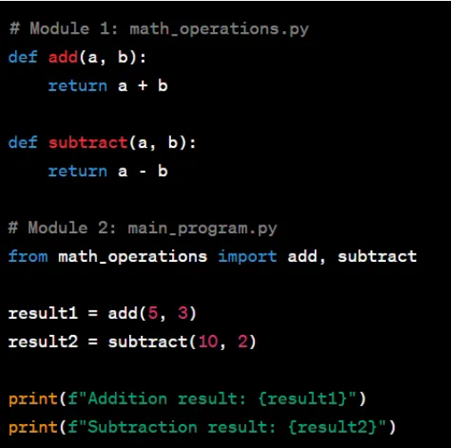
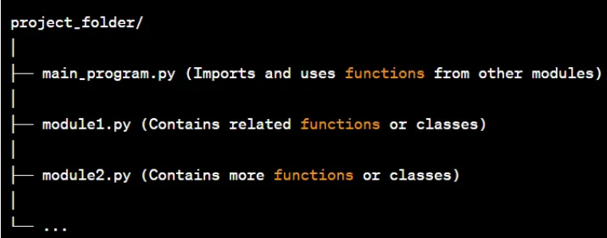
Modular Design
Breaking down a complex system into smaller, manageable,
and interchangeable components called modules.

Slide 5
Resist the Temptation to Go Fast
Navy SEALs Mantra –
“Slow is Smooth and Smooth is Fast”
Quality Over Speed
Example:-
Compare two projects, one rushed and full of issues, and one where time was taken
to ensure quality from the start.

Slide 6
Short-term Pain for Long-term Gain
Avoiding Quick Fixes
Maintaining Code Quality
Example:-
Implementing quick fixes or shortcuts to meet deadlines can lead to technical debt

Slide 7
Conclusion
Clarity is King
Importance of writing readable code and reducing usage of excessive comments
Avoiding Complexity
Follow the Single Responsibility Principle to keep code simple and manageable
Resist the Temptation to Go Fast
“Slow is smooth and smooth is Fast” – taking time to do things right leads to better
results
Short-term Pain for Long-term Gain
Proper planning, testing, and documentation lead to long-term success

Slide 8


